Slide 1
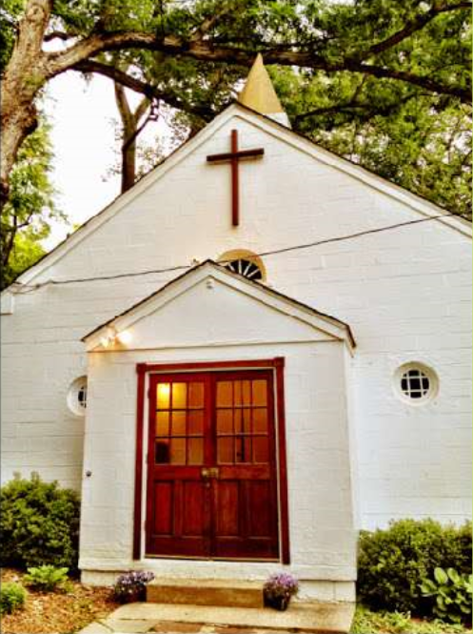
2nd Century Project
The historic Scotland Church was founded in 1905 by Black residents of the Scotland community in Potomac, Maryland. Over the years, the church has served as a pillar of the Black community of Scotland, providing a space for Sunday worship, Bible study, community meetings, food distribution, and addiction recovery meetings.
The church also played a key role as a tutoring hall in the 1960s “Save Our Scotland” (S.O.S.) campaign that aimed to protect the enclave of Scotland after it was designated as an urban renewal area. To prevent the community from being encroached upon by real estate developers, Scotland residents organized a grassroots campaign that resulted in the construction of new homes. The Scotland African Methodist Episcopal Zion congregation has survived over one hundred years as a testament to the power of community.

Slide 2
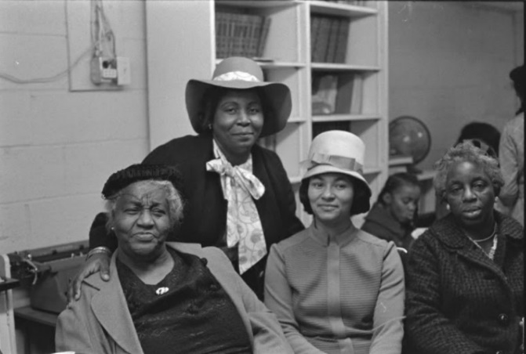
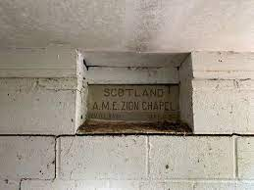
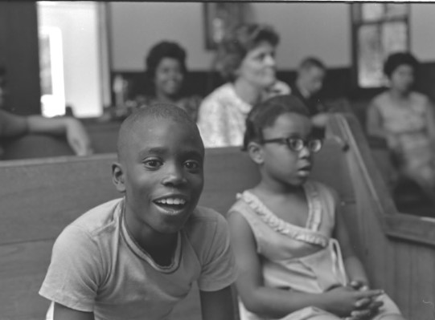
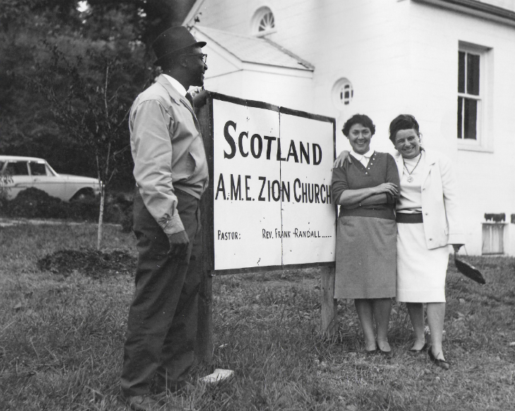
Scotland A.M.E. Zion Church
When the Scotland Church was first founded in 1905, it was known as the Warner Church and conducted services in a local home. In 1915, the church officially joined the African Methodist Episcopal (A.M.E.) Zion denomination and changed its name to recognize this affiliation. The cornerstone for the original church building reflects the name change and the date it was laid: September 14, 1924.
This building was constructed in its entirety by local church members and comprises a wooden frame with German siding and stained-glass windows in the pediment. When the congregation built an addition in the 1960s, again utilizing local residents for its construction, the original structure was used primarily for administrative functions.
Scotland A.M.E. Zion Church is registered as a State Historic Site by the Maryland Historical Trust and is the only historic building remaining in the Scotland community.

Slide 3
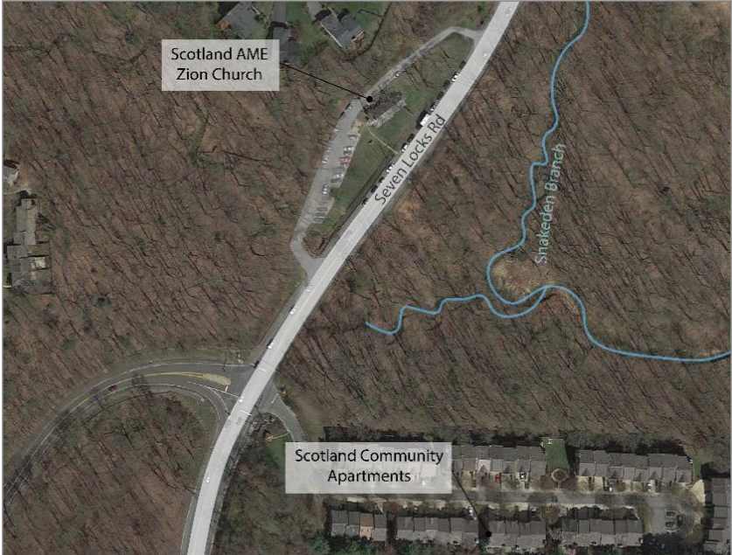
Scotland Community
Scotland is a predominantly Black community located in Maryland’s Montgomery County along Seven Locks Road in Potomac. The community was founded in March of 1880, when formerly enslaved people purchased land and built homes; descendants of the first Scotland families still live in the community today. Scotland became a self-sustaining community with a Rosenwald School, built in 1927. Although Scotland’s economy was primarily agricultural originally, residents moved to other forms of employment as Montgomery County’s agriculture waned in the beginning of the 20th century.

Slide 4
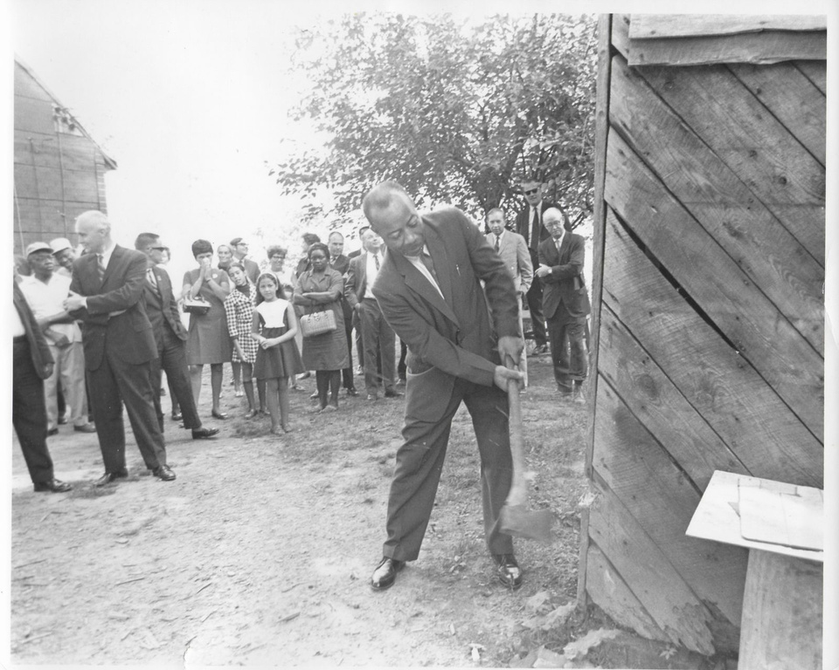
"Save Our Scotland"
In the 1950s and early 1960s, housing and commercial development and the expansion of Cabin John Park took over much of the Scotland land, which was denied access to public water and sewer due to discriminatory public policies. In response, Scotland residents created the “Save Our Scotland” (“S.O.S.”) committee in February of 1965, initiating a plan of action to protect and preserve the community. The committee organized trash cleaning activities, tutoring programs, and secured direct water and sewage lines to Scotland. “Save Our Scotland” committee members later formed a nonprofit organization, Scotland Community Development, that advocated for a rent-supplement program to the U.S. Senate and worked with the Suburban Maryland Fair Housing Authority to pass fair-housing legislation.

Slide 5
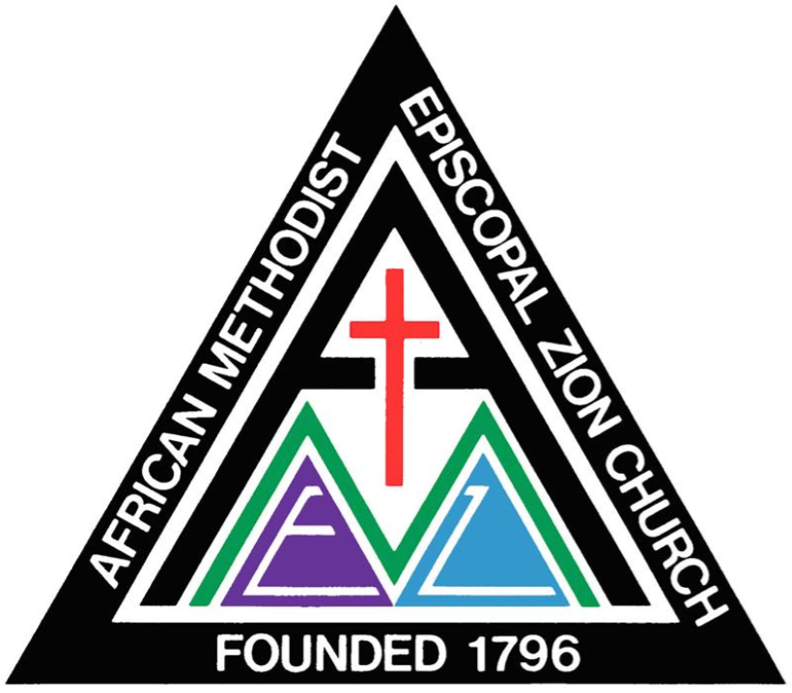
A.M.E. Zion Church
The African Methodist Episcopal Zion Church was founded in New York City in 1796 and organized in the South after the Civil War. A.M.E. Zion churches were built in response to discrimination against Black parishioners at majority white churches. The A.M.E. Zion denomination was organized by African American descendants of enslaved people, serving as a religious home for African Americans in cities around the United States. Past members of the A.M.E. Zion Church include Frederick Douglass, Harriet Tubman, Sojourner Truth, and Paul Robeson.

Slide 6
Flooding
In July 2019, a major storm caused flooding that damaged the original wood-frame structure, rendering it unsafe for church services. The congregation has been unable to use the building since and has been conducting services and programming both online and in other locations. Civil engineers have concluded that the church has been prone to flooding due to a long-ago decision by local officials, who built Seven Locks Road on higher ground just beyond the church’s front door.
Efforts are underway to restore this historic landmark and to build a new, sturdier home for the congregation. You can help.
See Scotland Church flood damage

Slide 7
2nd Century Project
A new campaign, the 2nd Century Project, is in place to both repair and preserve the historic significance of the church building, while also ensuring that the congregation has the resources to continue to maintain and grow its presence in the Scotland community. This three-phase campaign aims to raise funds to make the surrounding landscape and building flood-proof, restore the original church, and construct a new worship space that will nearly double the seating capacity.
Phase 1 - Restoration: We will rebuild the historic original structure, opened Sept. 14, 1924, to serve as a multi-use fellowship hall for the next 100 years.
Phase 2 - Regeneration: We will re-grade the surrounding landscape for resiliency against climate change to mitigate the risk of future flooding.
Phase 3 - Rejuvenation: We will construct a new state-of-the-art Scotland AME Zion Church to allow the congregation the opportunity to grow and serve its constituents into the next century.

Slide 8
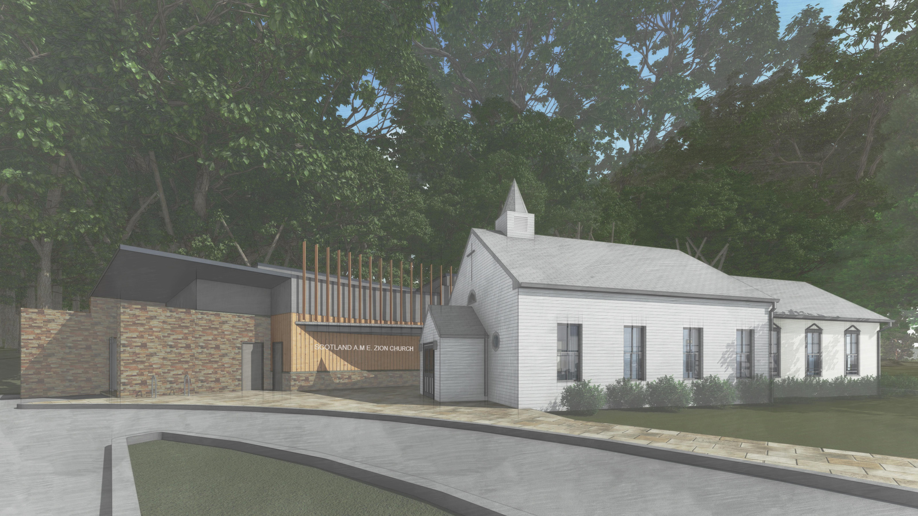
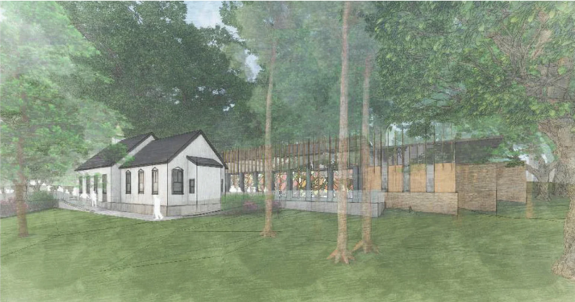
Restoration + Renovation Plans
The plan for the restoration of the original building involves the “Arc and Crown” method, which highlights and protects the existing historic structure alongside a new construction.

Slide 9
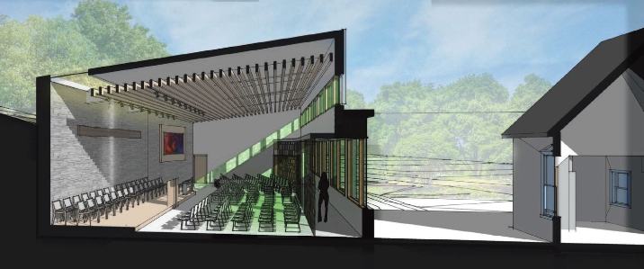
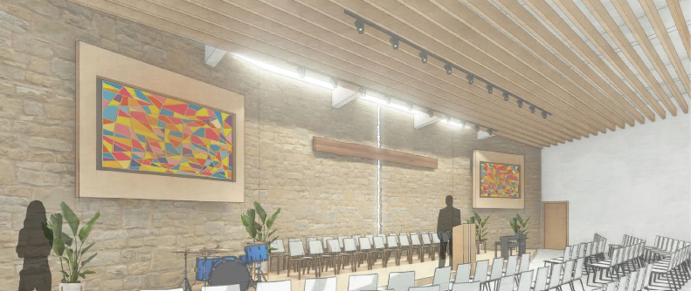
New Sanctuary Design
The new sanctuary behind the original church will provide a light-filled worship space that nearly doubles the current seating capacity. This will provide more opportunities for ministry and fellowship activities.

Slide 10
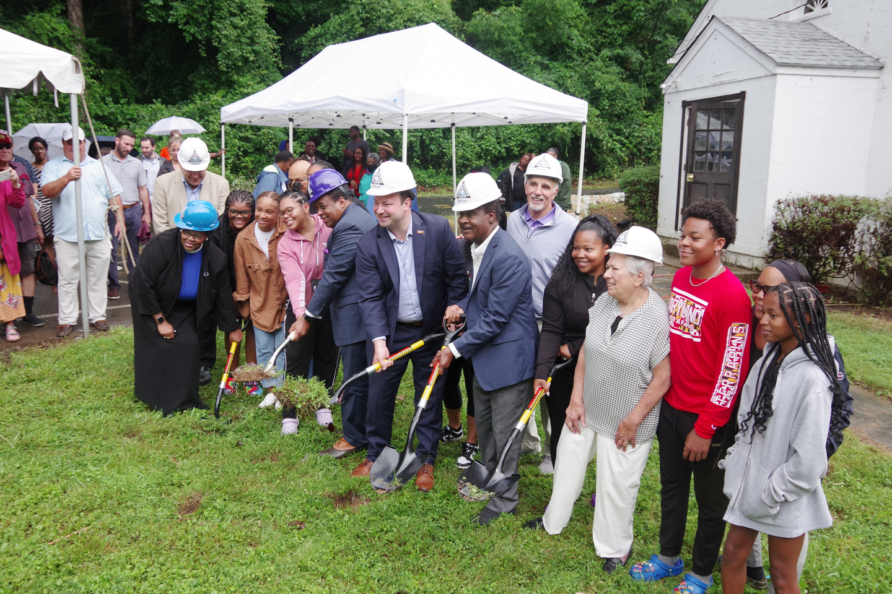
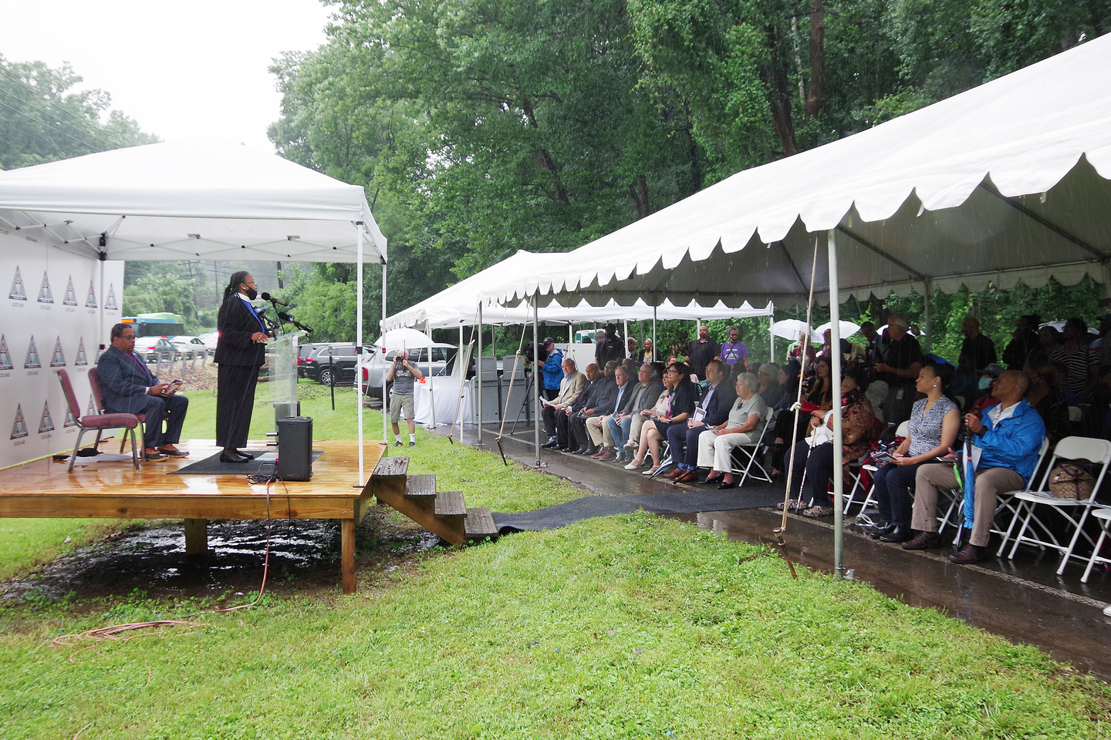
Groundbreaking
The inaugural groundbreaking of the 2nd Century Project was held on Saturday, July 9th, 2022. This marks the beginning of Phase 1 of the campaign to restore, regenerate, and rejuvenate the historic Scotland A.M.E. Zion Church.

Slide 11
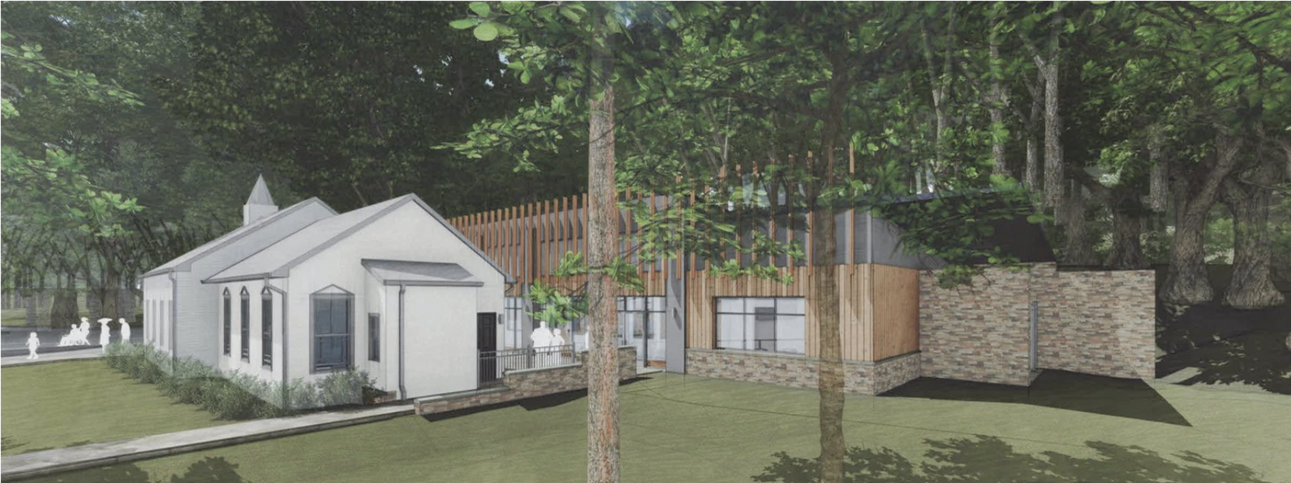
Press
AFRO: #FaithWorks: Scotland AME Zion Church Groundbreaking Ceremony
Bethesda Beat: 'A day of praise': Historic African American church in Potomac readies for renovation
Channel 4: Scotland AME Zion Church Breaks Ground in Potomac
Channel 4: Community Rebuilding Historic Maryland Church Damaged by Flood
DCist: This Historic Church Taught Black Children During Segregation. Now, It's Getting A New Building

Slide 12
You can help fund the 2nd Century Project and ensure the future of the Scotland A.M.E. Zion Church.
Help us reach our final funding gap!
WAYS TO GIVE
- Givelify
- GoFundMe
- Mail a check to:
Scotland A.M.E. Zion Church
10902 Seven Locks Road
Potomac, MD 20854

